Slide 2

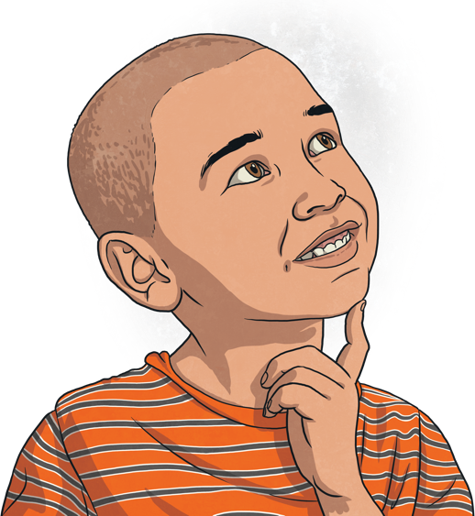
What Are Antonyms?
Antonyms are words that have opposite meanings.
For example, hot and cold are antonyms because their meanings are opposite.

Slide 3
What Are Antonyms?
Check out this list of antonyms:
fast
happy
big
thick
sink
awake
slow
sad
full
thin
float
asleep
empty
small
day
night

Slide 4

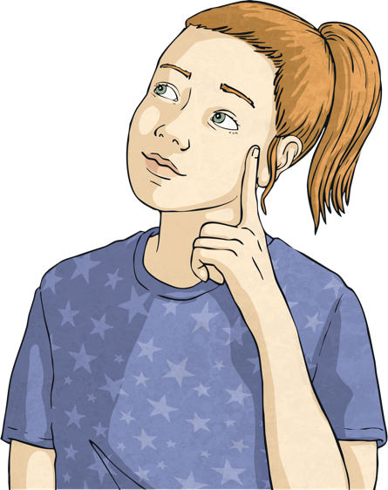
Your Turn!
Can you think of an antonym for each of these words?
attack
boring
careful
complicated
difficult
give
huge
lovely
native
reduce
safe
true

Slide 5
Using Antonyms
Antonyms can be used in your writing to help develop cohesion, clarify meaning and add detail.
Read through the examples over the next few slides and discuss how the antonyms have been used.

Slide 6

Using Antonyms - Example
The sky was clear and bright to the north, but as I looked to the south there seemed to be only dark and gloomy rain clouds on the horizon.
Think About: How does the use of antonyms help to make the writing feel cohesive?

Slide 7
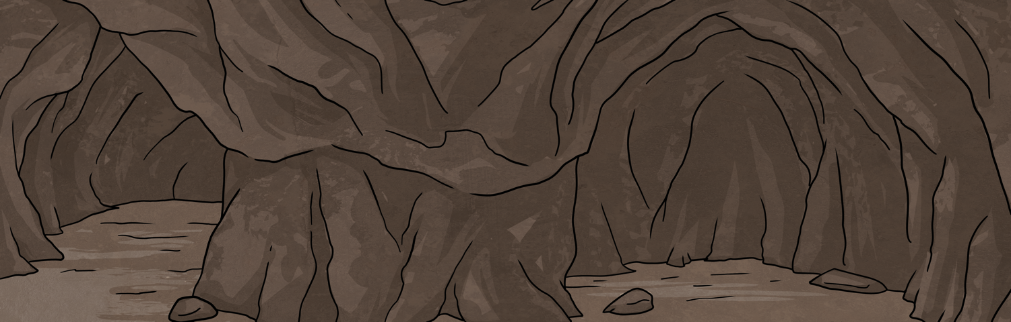
Using Antonyms - Example
She looked afraid as she stood at the mouth of the dragon’s cave, staring into the blackness.
She looked brave as she stood at the mouth of the dragon’s cave, staring into the blackness.
Think About: How does the meaning of the sentence change with the use of different antonyms?

Slide 8
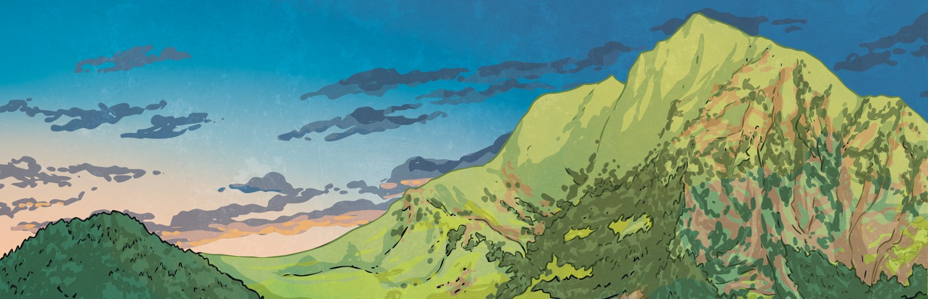
Using Antonyms - Example
We were so close to reaching the peak of the mountain but still so far behind the other teams that it hardly felt like an achievement at all.
Think About: How does the use of antonyms in this sentence add detail and clarify what is happening?

Slide 9
Your Turn!
Have a go at using the antonyms sweet and bitter to write a detailed, cohesive sentence or two opposing sentences.
Good luck!

