Slide 1
It was observed that the boys were all playing nicely at lunch time.

Slide 2
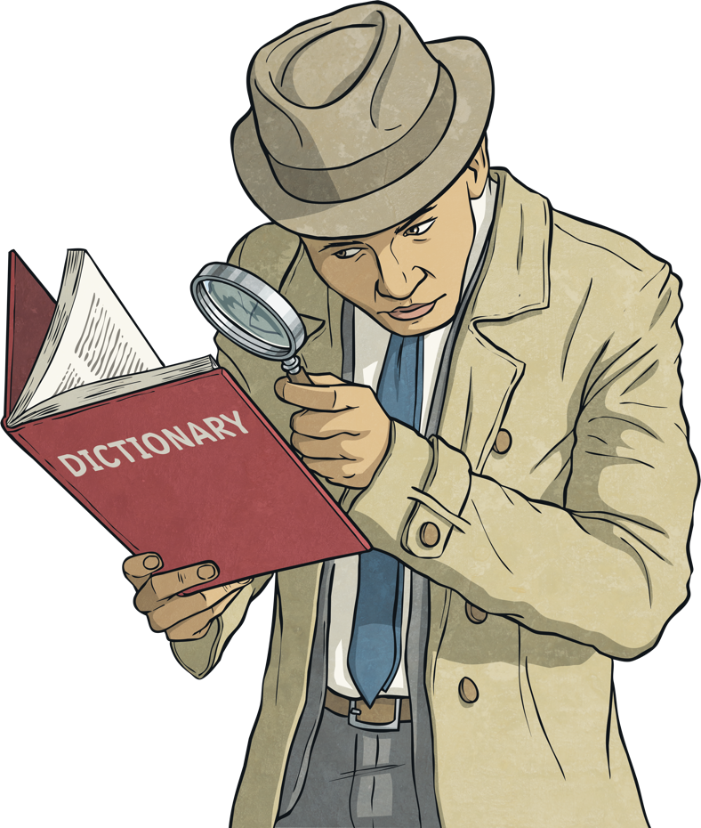
What is a Homonym?
Homonyms are two words which can have the same spelling or pronunciation, but have different meanings.
The word 'homonym' comes from the Greek word 'homonymos' which means 'having the same name’.
The prefix 'homo' means
the same, and the suffix
'nym' means name.
Therefore, homonyms are
two words that look and
sound exactly alike.

Slide 3
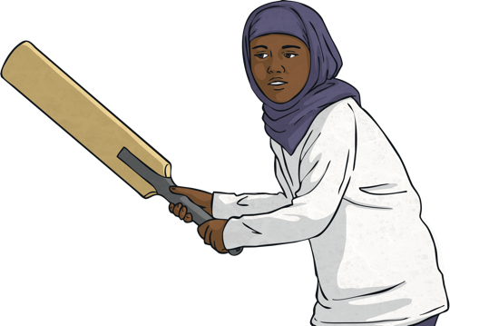
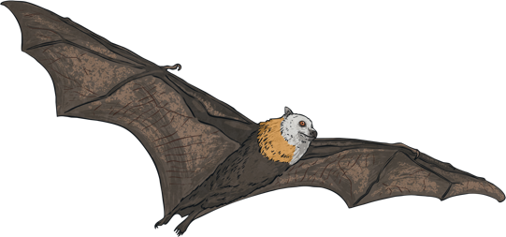
Examples of Homonyms
Bat
Bat

Slide 4
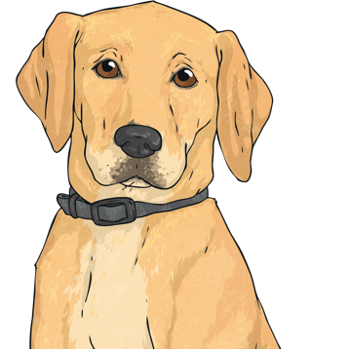
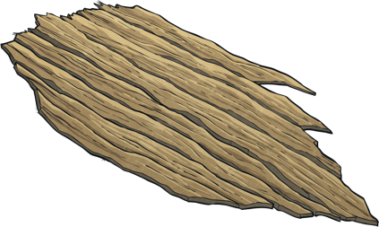
Examples of Homonyms
Bark
Bark

Slide 5

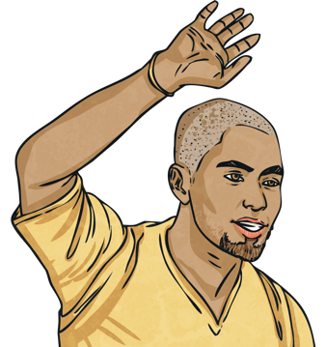
Examples of Homonyms
Wave
Wave

Slide 6
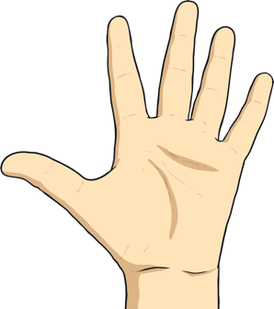
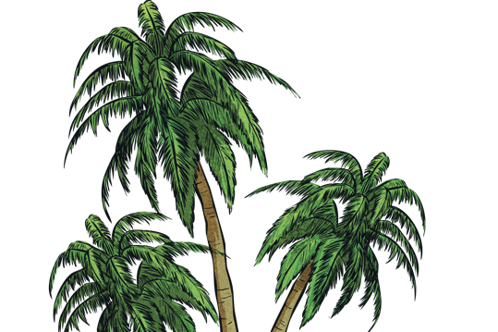
Examples of Homonyms
Palm
Palm

Slide 7
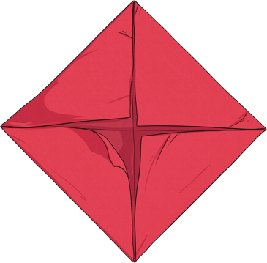
Examples of Homonyms
Diamond
Diamond

Slide 8

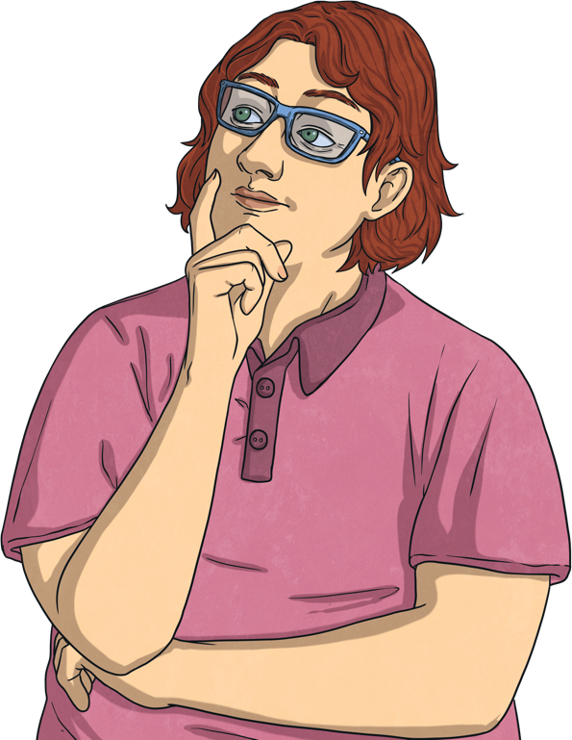
How many homonyms can you think of?

Slide 9
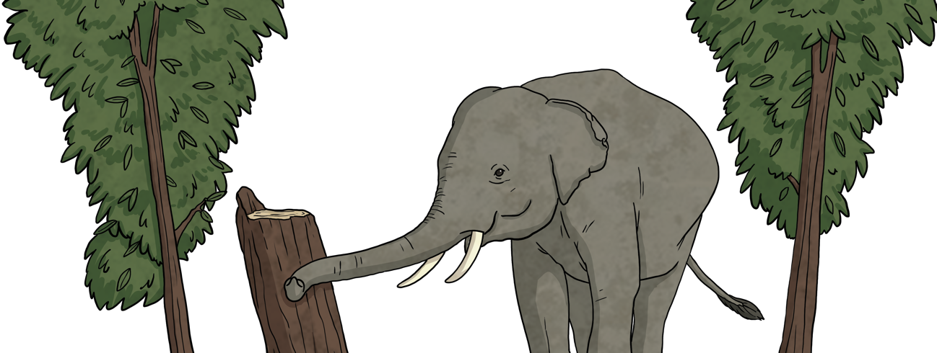
Homonyms in sentences
The elephant hit his trunk off the big brown tree trunk in the forest.

Slide 10
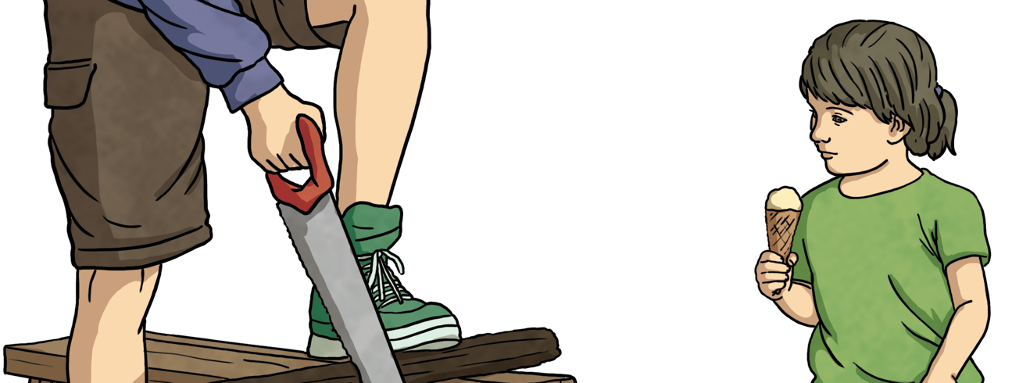
Homonyms in sentences
The little girl saw her uncle in the garden shed as he used his saw to cut the wood.

Slide 11
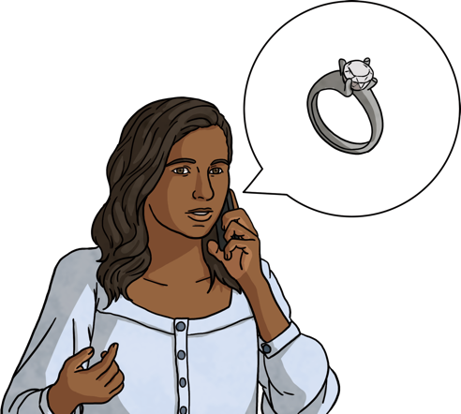
Homonyms in sentences
The lady picked up the phone to ring the shop to check if the diamond ring she ordered was in stock yet.

Slide 12
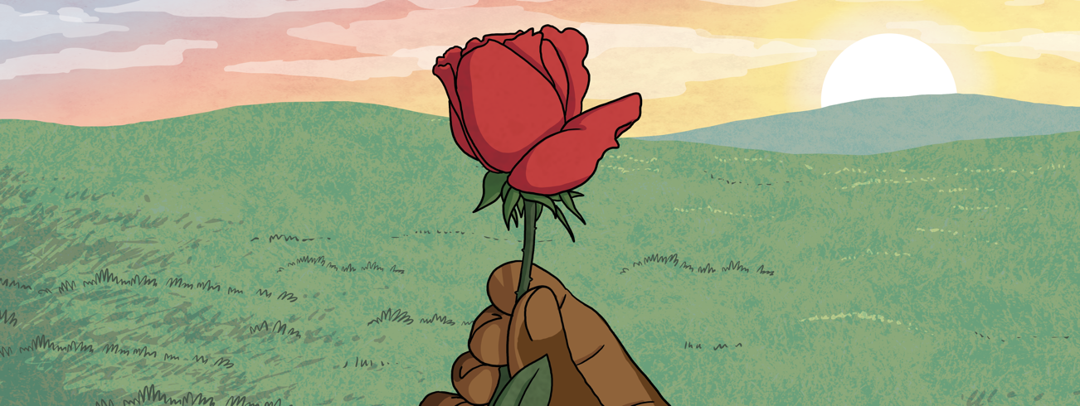
Homonyms in sentences
The sun rose early in the morning as I picked a red rose in the garden.

Slide 13
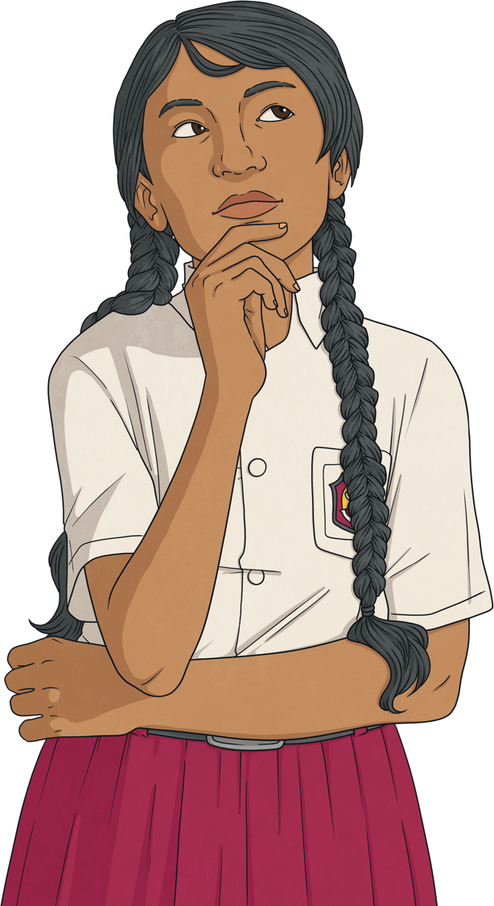
Can you think of sentences using homonyms?

