Slide 1

Modal Verbs

Slide 2
Modal verbs are auxiliary verbs which cannot usually work alone.
They are used with a main verb.
These are modal verbs:
might
will
should
may
would
can
could
must
shall
ought to

Slide 3
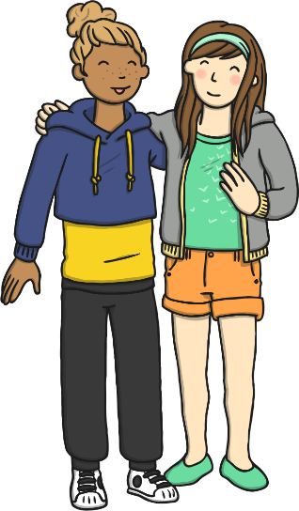


Modal verbs make questions by inversion.
She can go out.
Can she go out?
We could drive there.
Could we drive there?
Children should eat fruit.
Should children eat fruit?

Slide 4
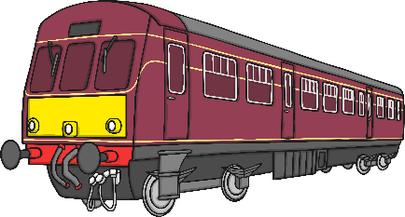


Modal verbs can be used to show how possible something is,
or how likely it is to happen/have happened.
For example:
He’s very late. He could have missed the train.
It’s snowing so it must be very cold outside.
They will lock the windows when they go out.

Slide 5
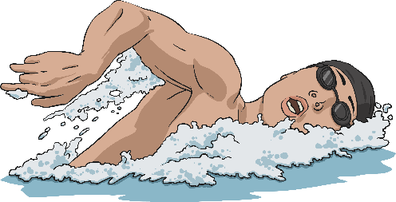




Can you spot the Modal verbs used
to show possibility in these sentences?
might
Mum might take us swimming after school.
could
You could eat a banana instead of those sweets.
will
Hurry up!
“Hurry up! We will be late!” said Dad
can
We can go the other way – it’s quicker.
You ought to go to bed earlier.
ought

Slide 6

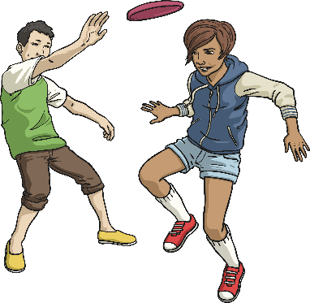
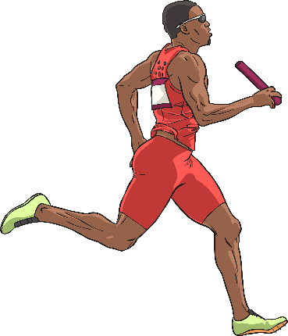
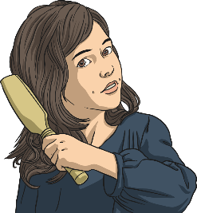
Which Modal verbs are missing
from these sentences?
must
You be hot in that thick coat.
shall
If it’s dry, we play outside?
He’s so fast, he win the race.
should
I’m fed up with my long hair. I have it cut.
might
Did you choose these modal verbs?
Which others could you have used?

Slide 7
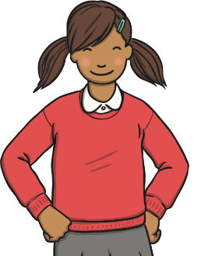


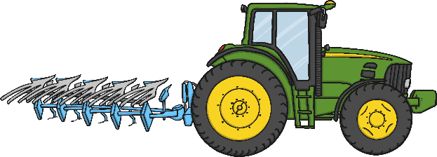
Modal verbs can also be used to show:
advice or obligation
habits
I will often have cereal for
my breakfast.
We shall always enjoy a
walk in the park.
Pupils must wear a uniform.
You should not smoke.
permission
ability
May I leave a few minutes early?
Could we go to the post
box on the way?
Please can we have an
ice cream?
I can drive a tractor.
My grandfather could
draw very well.

